Slide 1
GAME API
Discover, rate, and favorite your favorite games.
Present by: Vat Vannaden
Lecturer: Kim Ang Kheang

Slide 2

OVERVIEW
01
02
03
04
05
06
PROJECT ABOUT
WHAT IT SOLVE?
Challenges
Future plan
ER DIAGRAM
DEMO

Slide 3
INTRODUCTION

Slide 4
WHAT THE PROJECT IS ABOUT?
This project is a RESTful Game API built with Laravel that allows users to explore, rate, and favorite video games. It provides endpoints for managing games, publishers, and user interactions like ratings and favorites. The API supports full CRUD operations and authentication.
User Authentication (Token-based)
Game and Publisher CRUD operations
Favorite system (Many-to-Many)
Game Rating
(One-to-One)
User Authentication
(Token-based)
Game and Publisher CRUD operations

Slide 5
WHAT PROBLEM DOES IT SOLVE?
This Game API simplifies game data management by allowing users to view, rate, and favorite games.
It helps developers build gaming platforms faster by providing ready-to-use endpoints for games, publishers, and user ratings.
It also supports dynamic features like user-specific favorites and average game ratings.

Slide 6
DIFFICULTIES AND CHALLENGES
Designing clean relationships between tables
Handling token-based authentication
Structuring clear API endpoints while keeping response formats consistent.
Handling user authentication and relation mapping for ratings and favorites.
Ensuring accurate average rating updates across user submissions.

Slide 7
FUTURE PLAN
Add frontend (Vue.js or React)
Add user profiles with avatars (1-to-1)
Add more functions and improve the system
Deploy online for public API access

Slide 8
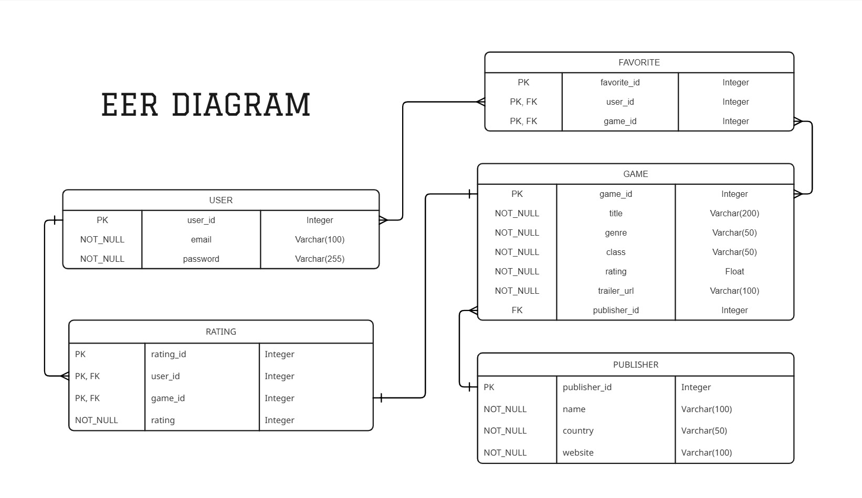

Slide 9


DEMO

Slide 10

THANKS!

